Slide 1
205 CRDBMS (Concepts of Relational Database Management System)

Slide 2
UNIT 1
INTRODUCTION
OF
RELATIONAL MODEL

Slide 3
RDBMS ?
DBMS is based on Relational Model is termed as “RDBMS”.
RDBMS stands for “Relational Database Management System”.
In RDBMS, tables are related to each other.
In RDBMS, relations are set using common columns between tables.
When there is a relationship between 2 or more tables than it is termed as “RDBMS”.

Slide 4
1. Student details Table 2. Student Result Table
ROLLNO | NAME | DOB | CLASS
1 | Raj Sharma | 11-12-2004 | FYBCA – B
2 | Priti Shah | 09-03-2005 | FYBCA – B
3 | Sneha Patel | 03-02-2005 | FYBCA – B
4 | Kirti Bajaj | 06-10-2005 | FYBCA – B
ROLLNO | CPPM | DPA | TOTAL | RESULT
1 | 80 | 7O | 150 | PASS
2 | 65 | 60 | 125 | PASS
3 | 30 | 20 | 50 | FAIL

Slide 5
Codd’s Rules (0-12)
Any DBMS which satisfies this (0-12) rules than we can say it as a RDBMS.
E.F Codd was a scientist who invented relational model for database management system.
He invent the rules, if one DBMS want to be RDBMS, he must follow some rules, these rules are called Codd’s 13(0-12) rules.

Slide 6
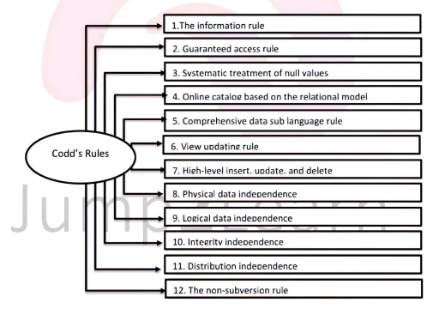
CODD’S RULES
0 . The Foundation Rule

Slide 7
RULE 0 : The Foundation Rule
For a system to qualify as a RDBMS, it must be able to manage its database.
System must be capable to manage the database.
RULE 1 : The Information Rule
All the information store in table, column or in a cell form only.
All information must be in a tabular form.

Slide 8
RULE 2: The Guaranteed Access Rule
Each unique piece of data must be logically accessible by the combination of :-
(Table name + Primary key + Attributes)
Database elements should be accessible by Primary Key, table name and column name.
Ex:
SELECT Age
FROM Student
WHERE Rollno=2;

Slide 9
RULE 3: Systematic treatment of NULL values
If there is any missing information or no value or unknown data or inapplicable information in a table, than this type of information is to systematically manage.
This type of information is termed as NULL value.
Blank space cannot be treated as NULL value.
Primary key should not be NULL
A DBMS must support Null Values to represent missing information and inapplicable information in a systematic manner independent of data types.

Slide 10
RULE 4: Dynamic/Active online catalogue based on Relational Model
Description or information related to database should be kept online, so that DBA can handle the query occurred.
Must have description of database.
Must have information about database.
Must have information about tables.
Must have information about no. of tables.
Must have information about what type of information in it.
Must have information about column names.
Database Dictionary must have description of database.
Only authorized user can access the database.

Slide 11
RULE 5: The Comprehensive data sublanguage rule
Must be one structured language whose statements, syntax and expressions are well defined.
Must have one well language to access, to create, to insert, to update, to delete or to manipulate data from it.
Must support the following concepts:-
Data Definition
Data Manipulation
Integrity Constraints
Authorization
Transaction Control

Slide 12
RULE 6: The View Updation
All views that are theoretically updatable are also update for the user.
Ex: Marketing(Sales View, Account View, Customer View)
All newly created views must be automatically updated.

Slide 13
RULE 7: The Relational level operation
Must support all facilities such as insert, update and delete.
Must support the operation like insertion, updation and deletion at each level of relations.
Set operations(relational algebra) like UNION, MINUS and INTERSECTION also be supported.

Slide 14
RULE 8: Physical Data Independence
Any physical changes may not affect the working of an application.
Application programs, user activities, structure of DB remains same if any changes made in storage representation or access methods.
Change in storage but not affect the logic.

Slide 15
RULE 9: Logical Data Independence
If there is change in the logic than it should not affect the application.
Any change in logical structure(table structure) of DB than the user view of data should not change.
Ex: If a Student table is split into 2 tables
(1. Student Details, 2.Student Result), a new view should give result as the join of the tables.

Slide 16
RULE 10: Integrity Independence
Must follow the rules of integrity constraints.
Ex: If student has roll no “2” than at the time of insertion it must be same “2”.
RULE 11: Distribution Independence
User should not have any knowledge of the DB use by him/her is used by other users also at the same time at any place.
RULE 12: Non–Subversion Rule
The database structure (catalog) should not be modifying without use of database language such as SQL.
Should not use any language except SQL.

Slide 17
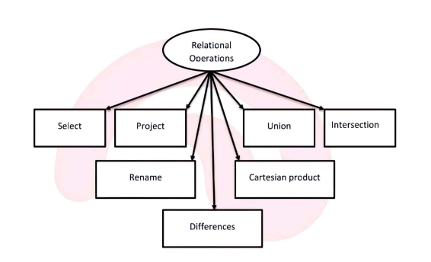
RELATIONAL OPERATIONS ALGEBRA

Slide 18
Relational Algebra in RDBMS
Select Operation (or σ)
Project Operation (or ∏)
Union Operation (or ∪)
Set Different Operation (or −)
Cartesian Product Operation (or Χ)
Rename Operation (or ρ)

Slide 19
1. SELECTION(σ)

Slide 20
2.PROJECTION(∏) ρ

Slide 21
3. UNION(∪)

Slide 22
4. SET DIFFERENCE(−)

Slide 23
5. RENAME(ρ)
It is denoted by symbol “ρ”
“ρ” is termed as rho.
Results of relational algebra are without name.
RENAME is used to name this results.
RENAME is use to naming the o/p.
Notation :
ρx(E)
Here “ρ” is used to rename
E is the result of expression which is saved with the name x

Slide 24
6.CARTESIAN PRODUCT(Χ)

